Slide 1

SECURE HASH ALGORITHM
Presented by
YASHWANTH KIRAN S
1BM19CS187
Under the guidance of
Basavaraj Jakkali
Associate Professor
Department of Computer Science and Engineering
BMS College and Engineering, Bengaluru

Slide 2
Outline
Introduction
1.1. Overview
1.2. Motivation
1.3. Objectives
2. Literature Survey
3. Methodology/Techniques or Algorithms used.
4. Tools used
5. Modules implementation and results.
5.1. Module 1 (Description with diagrams where ever required and results)
5.2. Module 2 (Description with diagrams where ever required and results)
References

Slide 3
INTRODUCTION
1.1 Overview
Secure Hash Algorithm (SHA) is a widely used cryptographic hash function that generates a unique fixed-size output, known as a hash, for a given input. The input can be any type of data, such as a message, a file, or a stream of data. The output, or hash, is a fixed-length string of characters that is unique to the input.
SHA is used to ensure the integrity and authenticity of data. It is commonly used in digital signatures, software integrity checks, and file integrity checks. There are several versions of SHA, including SHA-1, SHA-2, and SHA-3.

Slide 4
1.2 Motivation
The ability to ensure the integrity and authenticity of data is crucial in today's digital age, where data breaches and cyber attacks are becoming increasingly common.
Technical seminar on Secure Hash Algorithm provides a great opportunity to learn about the most recent developments and best practices in the field of cryptographic hashing, which is essential for cybersecurity professionals in today's digital age.
Comprehensive understanding of the basics and principles of hash functions and cryptographic hashing.

Slide 5
1.3 Objectives
The main objectives of Secure Hash Algorithm (SHA) include:
Data Integrity: The primary objective of SHA is to ensure the integrity of data by generating a unique fixed-size output, known as a hash, for a given input. This allows the recipient of the data to verify that the data has not been tampered with or altered in transit.
Authentication: SHA can also be used for authentication purposes by generating a hash for a given input and then comparing it to a known hash value. This allows for the verification of the identity of the sender or the authenticity of the data.
Data Security: SHA provides a level of security by making it difficult for an attacker to tamper with the data or create a fake version of it. The output, or hash, is a fixed-length string of characters that is unique to the input, making it difficult to predict the output for a given input.
Collision Resistance: SHA is designed to be collision-resistant, meaning it is difficult to find two different inputs that produce the same output hash.
Efficiency: SHA is designed to be efficient in terms of both computation time and memory usage. It is designed to be fast and efficient for both software and hardware implementations.
Versatility: There are several versions of SHA, including SHA-1, SHA-2, and SHA-3, each with different strengths and weaknesses. This allows for the appropriate version of the algorithm to be used depending on the specific use case or security requirements.

Slide 6
LITERATURE SURVEY
Froilan E. De Guzman , Bobby D. Gerardo and Ruji P. Medina in Implementation of Enhanced Secure Hash Algorithm Towards a Secured Web Portal[1] paper implemented the application of the enhanced secure hash algorithm-512 is implemented on web applications specifically in password hashing.
The enhanced hash function is deployed on the login module of web portals. In order to abide with existing security policies on the login module, the degree of password strength is considered as well as the range of password length.
The corresponding hash messages are stored on the database.The hash messages are the result of the enhanced secure hash algorithm in 512- bit message output.

Slide 7
Revati Raman Dewanagn, Deepali Thombre and Kaushlendra Sharma in Implementation of Secure Hash Algorithm Using JAVA Programming[2] implemented SHA using Java Programming.
Security is main issue when we talk about network , network based application and web based application or Web Services like SOAP(Simple object access protocol). Authentication of a user to learn his or her identity.
In this paper the authors have implemented SHA (Secure Hash Algorithm), that is much capable to do this job for secure authentication of user.

Slide 8
METHODOLOGY/TECHNOLOGY or ALGORITHMS USED
Secure Hash Algorithm (SHA) works by taking an input (or "message") and processing it through a series of mathematical operations to produce a fixed-size output, known as a "hash" or "digest."
The specific steps of the algorithm vary depending on the specific version of SHA, but generally, the process can be broken down into the following steps:
The input message is padded to a specific length, so that its size is a multiple of a certain block size.
The padded message is then divided into fixed-size blocks, and processed through a series of logical and mathematical operations, such as bitwise operations, logical functions and modular additions. These operations are designed to be complex and non-reversible, so that even small changes to the input result in a completely different output.
The output of each block is then combined with the input of the next block, and the process is repeated for all blocks of the message.
Finally, the output of the last block is truncated to produce a fixed-size output (hash) that represents the input message.
SHA-256 specifically takes a message of less than 2^64 bits in length and produces a 256-bit (32-byte) output.
The output generated by the algorithm is designed to be unique to the input, meaning that even a small change to the input will result in a completely different output. This makes it useful for detecting tampering or modifications to data.

Slide 9
SECURE HASH ALGORITHM
The Secure Hash Algorithms are a family of cryptographic hash functions published by the National Institute of Standards and Technology(NIST) as a U.S. Federal Information Processing Standard(FIPS), including:
SHA-0: A retronym applied to the original version of the 160-bit hash function published in 1993 under the name "SHA". It was withdrawn shortly after publication due to an undisclosed "significant flaw" and replaced by the slightly revised version SHA-1.
SHA-1: A 160-bit hash function which resembles the earlier MD5 algorithm. This was designed by the National Security Agency(NSA) to be part of the Digital Signature Algorithm. Cryptographic weaknesses were discovered in SHA-1, and the standard was no longer approved for most cryptographic uses after 2010.
SHA-2: A family of two similar hash functions, with different block sizes, known as SHA-256 and SHA-512. They differ in the word size; SHA-256 uses 32-bit words where SHA-512 uses 64-bit words. There are also truncated versions of each standard, known as SHA-224, SHA-384, SHA-512/224 and SHA-512/256. These were also designed by the NSA.

Slide 10
SECURE HASH ALGORITHM
SHA-256 is a cryptographic hash function that produces a 256-bit (32-byte) hash value. It is part of the SHA-2 family of hash functions, which also includes SHA-512. The function is designed to be collision-resistant, meaning it is computationally infeasible to find two inputs that produce the same hash value. SHA-256 is widely used in various applications such as digital signatures, file integrity verification, and password hashing. It is also used in various encryption and authentication protocols, such as SSL/TLS and IPSec. It is considered as a secure and widely used hash function. Since it produces shorter hash than sha512, it is faster and use less resources.
SHA-512 is a cryptographic hash function that produces a 512-bit (64-byte) hash value. It is part of the SHA-2 family of hash functions, which also includes SHA-256. The function is designed to be collision-resistant, meaning it is computationally infeasible to find two inputs that produce the same hash value. SHA-512 is commonly used to generate digital signatures and to verify the integrity of large files. It is also used in various encryption and authentication protocols, such as SSL and IPSec.
SHA-512 is generally considered to be more secure than SHA-256, as it offers a higher level of collision resistance. However, this also means that it requires more processing power and memory to compute, and may be less efficient for certain applications. SHA-256 is considered as a good balance between security and performance. It is widely used in industry standard.

Slide 11
TOOLS USED
Vscode editor.
Cryptography module in python : Python provides a built-in module called "hashlib" that includes a variety of cryptographic hash functions, including SHA-256. It can be used to easily hash data in python.
XAMPP server.
Crtyptool 2.

Slide 12
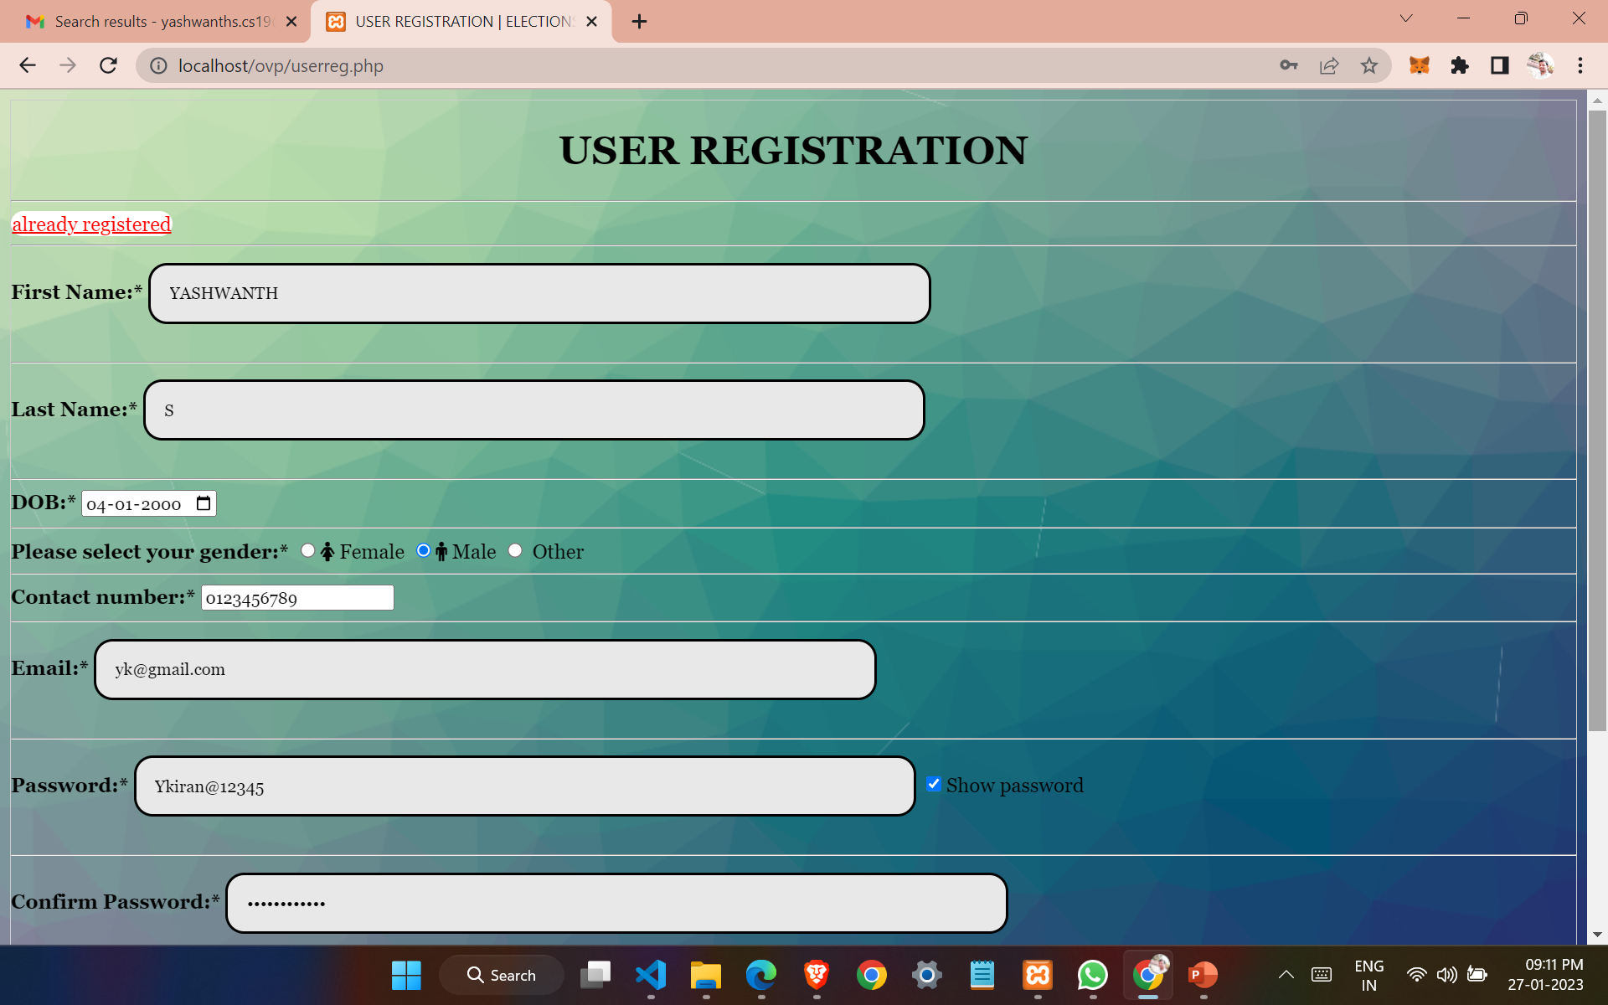
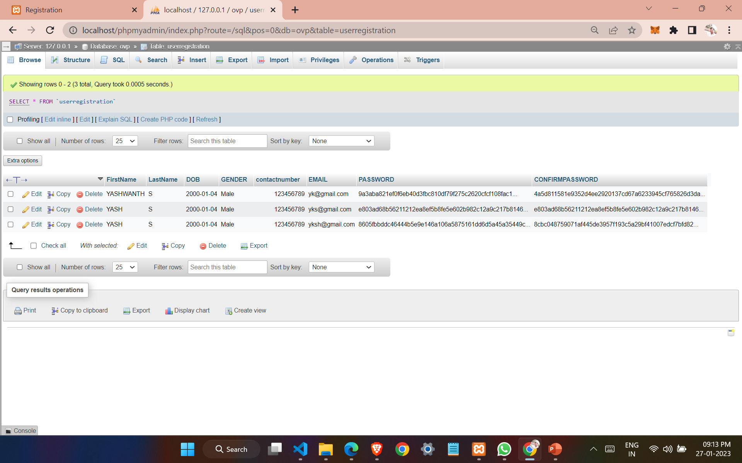
MODULES IMPLEMENTATION and RESULTS

Slide 13


Slide 14


Slide 15


Slide 16


Slide 17


Slide 18
REFERENCES
[1] F. E. De Guzman, B. D. Gerardo and R. P. Medina, "Implementation of Enhanced Secure Hash Algorithm Towards a Secured Web Portal," 2019 IEEE 4th International Conference on Computer and Communication Systems (ICCCS), Singapore, 2019, pp. 189-192, doi: 10.1109/CCOMS.2019.8821763.
[2] Implementation of Secure Hash Algorithm Using JAVA Programming Revati Raman Dewanagn, Deepali Thombre, Kaushlendra Sharma
[3] Adel, Radwa & Fouad, M. & Aboul-Dahab, Mohamed. (2013). DESIGN AND IMPLEMENTATION A NEW SECURITY HASH ALGORITHM BASED ON MD5 AND SHA-256. International Journal of Engineering Sciences & Emerging Technologies. 6. 29-36.
[4] F. E. De Guzman, B. D. Gerardo and R. P. Medina, "Enhanced Secure Hash Algorithm-512 based on Quadratic Function," 2018 IEEE 10th International Conference on Humanoid, Nanotechnology, Information Technology,Communication and Control, Environment and Management (HNICEM), Baguio City, Philippines, 2018, pp. 1-6, doi: 10.1109/HNICEM.2018.8666419.
[5] S. -H. Lee and K. -W. Shin, "An efficient implementation of SHA processor including three hash algorithms (SHA-512, SHA-512/224, SHA-512/256)," 2018 International Conference on Electronics, Information, and Communication (ICEIC), Honolulu, HI, USA, 2018, pp. 1-4, doi: 10.23919/ELINFOCOM.2018.8330578.

